Slide 1



Hardware and Software Fundamentals of Intelligent Computing Systems
Notes:
需要涉及的要点：
- 第一课时：Compute Architectures 的逐渐演化：由AI/ML workload 引导，逐渐展示出多种多样的架构，如华为达芬奇、AMD等等
- 第二课时：互联的硬件基础，与CUDA core、Tensor core 的编程。
- 可能还需要涉及的点：课程整体设计（Syllabus、各个模块的内容，根据教学大纲生成了个overview的图）

Slide 2
Lecture 05: Environment Setup and Toolchain Configuration

Slide 3
Course Projects Overview
Lecture | Project Name | Type | Key Assessment Criteria
5 | Environment Setup and Toolchain | Lab Session | Four-Phase Operational Verification + + Lab Report
9 | Softmax Kernel (Midterm) | Individual Project | Correctness 40pts + Performance70% Threshold
18 | RMSNorm+Residual Fusion (Final) | Individual Project | Performance must reach FlagGems Benchmark 90%
27 | FlagTree Pass Contribution (Final) | Individual Project | Choose from 3 directions, FileCheck Test Verification
36 | 7B Multi-Node Distributed Training (Final) | 3-Person Team | Comparison of 3 Parallelism Strategies + + Linear Speedup Ratio
46-47 | Capstone Project Defense | Group Defense | Proposal Feasibility + + Authenticity of Progress

Slide 4
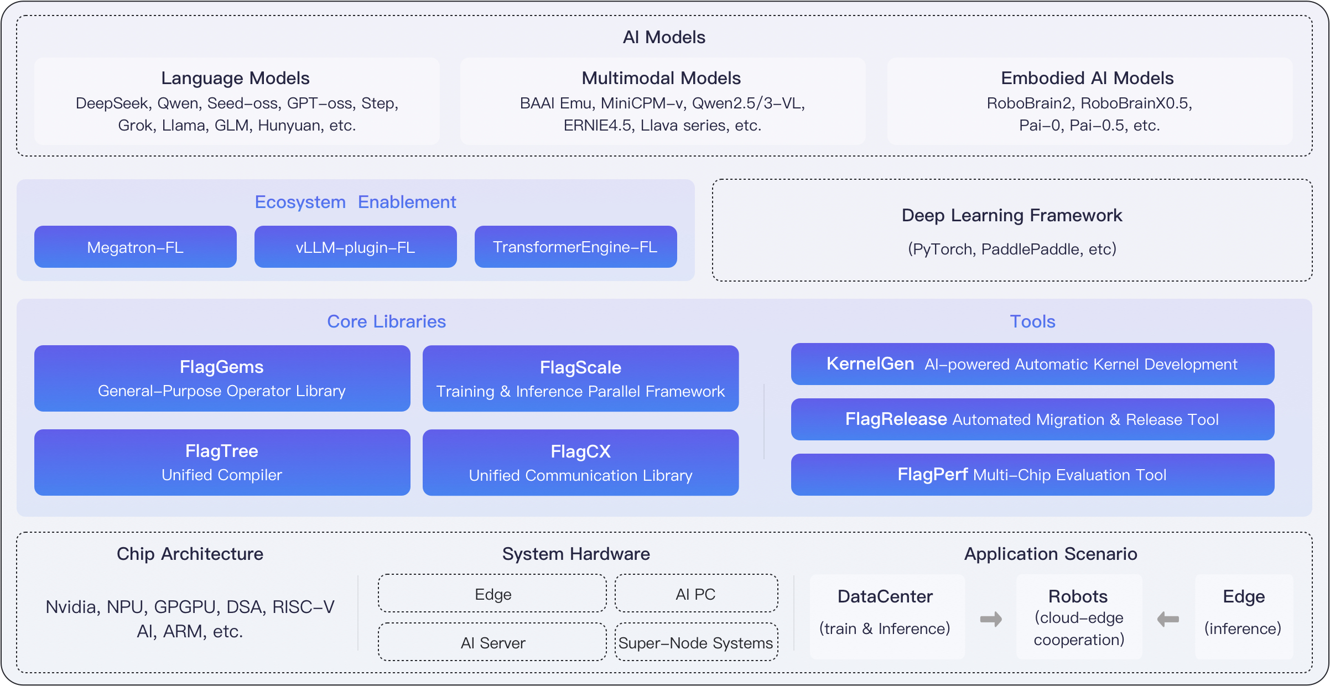
FlagOS Ecosystem Overview
Design Philosophy: “Model-System-Chip” Decoupling, “Develop Once, Run Everywhere” 。
KernelGen (Intelligent Source): LLM -Driven Operator Generation and Test Verification Agent 。
FlagGems (High-Performance Operator Library): Based on Triton , a High-Performance Generalized Operator Library.
FlagTree (Compilation Engine): A Unified MLIR Compiler Bridging Operators to Over Ten Heterogeneous Chip Architectures.
https://docs.flagos.io/en/latest/overview.html

Slide 5
Project Overview
LabObjectives
Independently complete FlagOS development environment setup (Docker or Conda route)
Successfully install and verify CUDA Toolkit（NVCC) and Triton Compiler
Clone flagos-ai/FlagGems repository and pass compilation verification
Run the first Hello World Triton Kernel, understand the basic execution workflow
Prerequisites: Lectures 1–4 foundational theory; basic Linux command-line proficiency; GitHub account

Slide 6
Lab Environment Specifications
Hardware Requirements
NVIDIA GPU（Compute Capability ≥ 8.0, recommended: A100/A800 or RTX 30 series or above)
Memory ≥ 16 GB, Disk Space ≥ 50 GB
Software Dependencies
OS Ubuntu 20.04 / 22.04 LTS (recommended)
CUDA Toolkit 12.1 or 12.2 (compatible with PyTorch 2.x )
Python Environment 3.10 or 3.11
Docker Version ≥ 24.0 (optional route)

Slide 7
Lab Procedures
Phase A: Environment Selection and Initialization
Choose one of the following two routes based on available resources
Route 1 — Docker (Recommended)
docker pull nvcr.io/nvidia/pytorch:24.03-py3
docker run --gpus all -it --name flaggems-dev -v $(pwd):/workspace ...
Route 2 — Conda
conda create -n flaggems python=3.11 -y
conda activate flaggems
pip install torch==2.3.0 triton==2.3.0

Slide 8
Lab Procedures
Phase B：NVCC and CUDA Verification
Phase C: Clone FlagGems and Install
nvcc --version # Verify CUDA version
nvidia-smi # Verify GPU visibility
python -c "import torch; print(torch.cuda.is_available())"
git clone https://github.com/flagos-ai/FlagGems.git
cd FlagGems
pip install -e . # Install in development mode
python -c "import flag_gems; print('FlagGems OK')"

Slide 9
Lab Procedures
Phase D：Hello World Triton Kernel
Write and run the following minimal Triton Kernel to complete print output verification
Observe Triton 's JIT compilation output; record in the lab report the PTX file path and Kernel launch time.
import triton, triton.language as tl, torch
@triton.jit
def hello_kernel(x_ptr, out_ptr, n: tl.constexpr):
idx = tl.program_id(0)
x = tl.load(x_ptr + idx)
tl.store(out_ptr + idx, x * 2)

Slide 10
Submission Requirements and Grading Criteria
Lab Report Requirements
Screenshots: terminal output of all four phases (nvcc version, GPU info, FlagGems import success, Kernel output)
Text: describe encountered environment issues and resolution
Analysis: compare Docker and Conda routes - pros and cons (within 200 words)
Bonus (optional): draw a toolchain call graph from Python code to GPU execution
Grading Criteria
Assessment Dimension | Score | Grading Criteria
Environment Configuration Completeness | 40 pts | All four phases completed with screenshot evidence
Kernel Execution Verification | 30 pts | Hello World output correct, compilation parameters recorded
Lab Report Quality | 20 pts | Thorough analysis, clear troubleshooting approach
Bonus | 10 pts | Toolchain call graph accurate and complete

Slide 11

The Solution: FlagOS, a Unified AI Software Stack

Slide 12








https://space.bilibili.com/3546791834290849
https://github.com/flagos-ai
https://www.zhihu.com/people/95-22-20-18/posts
https://flagos.io/Home

Slide 13

Thanks for your time！

